Slide 1

Banking Rules on Documentary Collections/Negotiation/Compliance/
Negotiation/Discrepancy/Settlement
The Global Business Model
The Trade Process Concepts – Settlement
Banking Rules on Documentary Collections
Banking Rules on Letter of Credit
Export Documentation
Negotiation / Presentation / Examination of Documents
What is LC Discrepancy
Instructions for Opening a Letter of Credit
Examination of a Letter of Credit
Calculation of due date
Presented By: Woon ( Dec 29, 2011 )

Slide 2
TOP GLOVE, TOP QUALITY, TOP EFFICIENCY
GOOD HEALTH, SAFETY FIRST & BE HONEST
The Global Business Model
A business process for conducting trade that is defined by globally recognized trade forms and documents.
Trade – The exchange of tangible goods or services between a seller and a buyer in another country for cash, acceptance or other goods.
Trade Finance – The settlement (reimbursement for title) of a trade transaction with a Documentary Letter of Credit, Standby Letter of Credit, Documentary Collection or Bill of Exchange, through the international banking system.
Notes:
The Global Trade Business Model is a business process for conducting trade that is defined by globally recognized trade forms and documents.
The definition of “Trade” is the exchange of tangible goods or services between a seller and a buyer in another country for cash, acceptance or other goods.
The definition of “Trade Finance” is the settlement, or reimbursement for title using a Documentary Letter of Credit, Standby Letter of Credit, Documentary Collection, or Bill of Exchange through the international banking system.

Slide 3

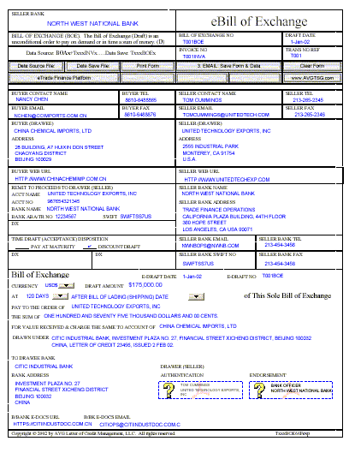




TOP GLOVE, TOP QUALITY, TOP EFFICIENCY
GOOD HEALTH, SAFETY FIRST & BE HONEST
e
The Trade Process - Concept
1. Sale
2. Performance
Seller
3. Logistics
4. Settlement
Buyer
Notes:
The traditional trading process has four basic steps leading to the exchange of goods for reimbursement.
The “Sale” phase.
The “Performance” phase.
The “Logistics” phase.
And the “Settlement” phase.

Slide 4
TOP GLOVE, TOP QUALITY, TOP EFFICIENCY
GOOD HEALTH, SAFETY FIRST & BE HONEST
e
The Trade Process
Sale – Finding the buyer and/or seller leading to a Purchase Order.
Performance – Manufacturing or staging the goods for shipment.
Logistics – Moving the goods from the export to the import country.
Settlement – Exchanging title to the goods from the seller to the buyer.
Notes:
The Sale phase consists of finding the buyer and/or seller leading to a Purchase Order.
The Performance phase involves the manufacturing and staging of the goods ready for shipment.
The Logistics phase involves moving the goods from the export to the import country.
The Settlement phase involves the exchange of title for the goods from the seller to the buyer.

Slide 5
TOP GLOVE, TOP QUALITY, TOP EFFICIENCY
GOOD HEALTH, SAFETY FIRST & BE HONEST
The Settlement Phase
International Payment Methods
Documentary Letter of Credit – Payment at shipment.
Documentary Trade Credit – Payment at shipment.
Documents Payment – Payment upon delivery.
Documents Acceptance – Acceptance upon deliver.
Clean Collection – Cash in advance of shipment.
Open Account – Payment upon presentation of invoice.
Notes:
The Settlement Phase process depends on which international payment method the buyer and seller have selected.
There are six basic payment methods for international settlement.
1. Documentary Letter of Credit for payment at shipment by a bank.
2. Documentary Trade Credit for payment at shipment by the seller.
3. Documents Payment for payment upon delivery.
4. Documents Acceptance for payment by a promissory note upon delivery.
5. Clean Collection for cash in advance of shipment.
And 6. Open Account for payment upon presentation of a commercial invoice after shipment.

Slide 6
TOP GLOVE, TOP QUALITY, TOP EFFICIENCY
GOOD HEALTH, SAFETY FIRST & BE HONEST
e
Basic Payment Methods
Method | Timing Payment | Goods Available | Risk
Clean Collection | Before Shipment | At Destination | None to Seller
Sight LC | Presentation of Docs | When LC is paid | Minimal to Seller
Usance LC | Maturity of B/A | At acceptance of draft | Minimal to Seller
D/P Collection | Presenting Bank | When payment made | Non-payment, goods returned.
D/A Collection | Trade Draft Matures | When Draft is accepted | Non-payment, goods with Buyer
Open Account | Buyer’s Discretion | Upon arrival | Reliance of Buyer
Notes:
There are six basic payment methods for settling trade transactions. One is not better than another, rather they are options that the buyer and seller may chose.
A “Clean Collection” is an advance payment since payment is made before shipment. The goods are already paid for and are available at their destination. There is no risk of non-payment to the seller since he is already paid.
A “Sight LC” is paid upon presentation and negotiation of the required documents. The goods are available when the LC is paid. There is minimal risk to the seller since the issuing bank is responsible for payment.
A “Usance LC” is paid upon maturity at acceptance of the sellers draft. The goods are available to the buyer upon the issuing banks acceptance of the draft. There is minimal risk to the seller since the issuing bank is responsible for payment.
A “D/P Collection” is Documents Against Payment. The goods are available to the buyer when he pays the amount requested by the seller for the goods.
A “D/A Collection” is Documents Against Acceptance. The goods are available to the buyer when he accepts the obligation to pay the seller upon maturity of the Bill of Exchange.
Open Account is paid by the buyer based on the terms stated in the submitted invoice.

Slide 7
Basic Terms of Payment
TOP GLOVE, TOP QUALITY, TOP EFFICIENCY
GOOD HEALTH, SAFETY FIRST & BE HONEST

Slide 8
Risks Associated with Terms of Payment
TOP GLOVE, TOP QUALITY, TOP EFFICIENCY
GOOD HEALTH, SAFETY FIRST & BE HONEST
Buyer
Seller
High
Open Account
Low
R
Documentary Collection
I
R
S
I
K
Letter of Credit
S
K
Low
Cash in Advance
High

Slide 9
Open Account
TOP GLOVE, TOP QUALITY, TOP EFFICIENCY
GOOD HEALTH, SAFETY FIRST & BE HONEST
Seller Bears All Risks
  Commercial
  Country
No Risk to Buyer (Importer)

Slide 10
Documentary Collections
TOP GLOVE, TOP QUALITY, TOP EFFICIENCY
GOOD HEALTH, SAFETY FIRST & BE HONEST
An order by the seller to his bank to collect payment/acceptance from the buyer in exchange for the transfer of documents that enable the holder to take possession of the goods.
Unlike letters of credit, banks involved in the transaction do not guarantee payment but act only as collectors of payment.

Slide 11
Common Terms for Collections
TOP GLOVE, TOP QUALITY, TOP EFFICIENCY
GOOD HEALTH, SAFETY FIRST & BE HONEST
Documents Against Payment (D/P)
Documents Against Acceptance (D/A)

Slide 12

TOP GLOVE, TOP QUALITY, TOP EFFICIENCY
GOOD HEALTH, SAFETY FIRST & BE HONEST
Exporter
Importer
Documents
$$
Remitting Bank
Collecting Bank

Slide 13

Letters of Credit
TOP GLOVE, TOP QUALITY, TOP EFFICIENCY
GOOD HEALTH, SAFETY FIRST & BE HONEST
Definition
  A letter of credit is a document
  issued by a bank
  to an individual or corporation
  by which the bank substitutes its own credit for that of its customer
Payable against presentation of documents which comply 100% with terms in LC

Slide 14
Letters of Credit
TOP GLOVE, TOP QUALITY, TOP EFFICIENCY
GOOD HEALTH, SAFETY FIRST & BE HONEST
Governed by Rules
  Uniform Customs and Practice for Documentary Credits, International Chamber of Commerce Publication No. 600
Banks Deal in Documents, not Goods.
Payment Must be Made for Conforming Documents.

Slide 15
Regulations
TOP GLOVE, TOP QUALITY, TOP EFFICIENCY
GOOD HEALTH, SAFETY FIRST & BE HONEST
ICC Uniform Customs and Practices Publication - UCP 600 – 2007 Revision
ISBP 681 – International Standard Banking Practice – for the examination of documents under Letter of credits
Federal Reserve Bank Regulations
ICC Uniform Rules for Bank-to-Bank Reimbursements – URR 725
ISP 98 - for Standby LC’ s

Slide 16
Parties to a Letter of Credit
TOP GLOVE, TOP QUALITY, TOP EFFICIENCY
GOOD HEALTH, SAFETY FIRST & BE HONEST
Applicant
Beneficiary
Issuing (Opening) Bank
Advising Bank
Confirming Bank
Negotiating Bank
Reimbursing Bank

Slide 17




LC Issuance Process
TOP GLOVE, TOP QUALITY, TOP EFFICIENCY
GOOD HEALTH, SAFETY FIRST & BE HONEST
Buyer’s Country
Seller’s Country
Sales contract
Buyer/Applicant
Seller/Beneficiary
Buyer applies
for LC. Credit
relationship
required
Seller’s bank
authenticates LC
and sends to seller
Buyer’s bank issues
LC and sends to
seller’s bank
Issuing Bank
Advising Bank

Slide 18
Common Letter of Credit Terms
TOP GLOVE, TOP QUALITY, TOP EFFICIENCY
GOOD HEALTH, SAFETY FIRST & BE HONEST
Sight
  Payment is Due When Conforming Documents Are Presented
Usance - Banker’s Acceptance
  Payment is Due at a Later Date up to 180 Days
  Can be Paid at a Discount Before Maturity

Slide 19



LC Payment Process
TOP GLOVE, TOP QUALITY, TOP EFFICIENCY
GOOD HEALTH, SAFETY FIRST & BE HONEST
Buyer’s Country
Seller’s Country
Shipment
Buyer/Applicant
Seller/Beneficiary
1. Bene sends
documents to bank
2. Bank examines
3. If OK, bank
starts payment
process
8. Iss Bk gets
documents
9. They examine
10. Docs released
to buyer
5. Iss. Bk
obtains funds
from buyer
7. Adv Bk
pays bene
6. Iss. Bk pays Adv. Bk.
Issuing Bank
4. Adv. Bk sends claim
to issuing bank; also sends
documents
Advising Bank

Slide 20
TOP GLOVE, TOP QUALITY, TOP EFFICIENCY
GOOD HEALTH, SAFETY FIRST & BE HONEST
e
The Settlement Process
Export Documentation
Notes:
The settlement process depends on trade and transport documents, these documents include:
The Proforma Invoice, an estimate of the final invoice before shipment.
The Letter of Credit Instructions, the terms and conditions for the buyers application for a Letter of Credit.
The Letter of Credit Application, the application to the buyer’s bank for a Letter of Credit.
The Documentary Letter of Credit, issued by the buyer’s bank.
The Letter of Credit Advice, the advice of a Credit to the seller.
The Export License, sometimes required for export.
And the Shipper’s Letter of Instructions, which is the exporters shipping and document instructions to the freight forwarder or carrier.

Slide 21
WHAT IS EXPORT DOCUMENTATION?
TOP GLOVE, TOP QUALITY, TOP EFFICIENCY
GOOD HEALTH, SAFETY FIRST & BE HONEST
The paperwork that is required for an export sales transaction
The means by which the shipping process is facilitated and recorded.
Documentation is essential for moving goods through the channels of distribution, transferring responsibility or possession, clearing goods through customs, and facilitating payment according to the agreed upon terms.

Slide 22
WHAT IS THE PURPOSE OF EXPORT DOCUMENTATION?
TOP GLOVE, TOP QUALITY, TOP EFFICIENCY
GOOD HEALTH, SAFETY FIRST & BE HONEST
Export documentation provides evidence that the negotiated terms between the buyer and the seller have been complied with. This is essential if the seller wishes to get paid
Export documentation provides important information that is used by the seller, the freight companies, governments, and the buyer.

Slide 23
THE KEY INFORMATION
CONTAINED IN EXPORT DOCUMENTS
Description of the goods
Mode of transportation
  rail, air, ocean
Terms of sale
  Who pays for what?
Origin of the goods
Identity of the seller/shipper
Identity of the buyer
Terms of payment
Evidence of shipment
Foley, James, F. “The Global Entrepreneur: Taking Your Business International.” Dearborn Financial Publishing. 1999. P. 210.

Slide 24
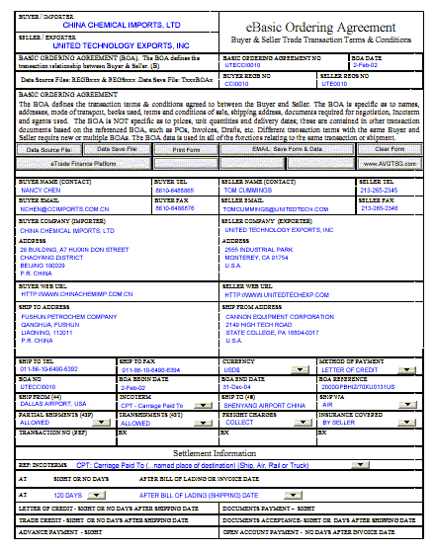
TOP GLOVE, TOP QUALITY, TOP EFFICIENCY
GOOD HEALTH, SAFETY FIRST & BE HONEST
The Settlement Process – Documents
Packing List – Actual contents of shipment
Commercial Invoice – Value of the goods and services
Certificate of Origin – Evidence of the origin of the goods
Beneficiary’s Certificate –Statement that a requirement is true or
accomplished
Quality Certificate – Seller’s or third party statement of quality compliance
Certificate of Insurance – Cargo Insurance amounts and conditions
Ships Register Certificate – Age and register of cargo carrying vessel.
Bill of Exchange – Demand for payment
Notes:
Addition Settlement documents include:
The Packing List, evidences the actual contents of shipment
The Commercial Invoice, states the value of the goods shipped.
The Certificate of Origin, evidences the origin of the goods
The Beneficiary’s Certificate is a statement that a requirement is true or has been accomplished.
The Quality Certificate, the seller’s or third party statement of quality compliance.
The Certificate of Insurance, states the amount of cargo Insurance and conditions of it’s application.
The Ships Register Certificate, states the age and register of the cargo carrying vessel.
And the Bill of Exchange, the seller’s demand for payment.

Slide 25
TOP GLOVE, TOP QUALITY, TOP EFFICIENCY
GOOD HEALTH, SAFETY FIRST & BE HONEST
The Settlement Process – Documents (continued)
Bill of Lading – Ocean or Marine Bill of Lading
Air Waybill – Air Waybill or Consignment Note for air shipment
TABLE CONTENTS
Notes:
Addition Settlement documents include:
The Packing List, evidences the actual contents of shipment
The Commercial Invoice, states the value of the goods shipped.
The Certificate of Origin, evidences the origin of the goods
The Beneficiary’s Certificate is a statement that a requirement is true or has been accomplished.
The Quality Certificate, the seller’s or third party statement of quality compliance.
The Certificate of Insurance, states the amount of cargo Insurance and conditions of it’s application.
The Ships Register Certificate, states the age and register of the cargo carrying vessel.
And the Bill of Exchange, the seller’s demand for payment.

Slide 26
Negotiation
TOP GLOVE, TOP QUALITY, TOP EFFICIENCY
GOOD HEALTH, SAFETY FIRST & BE HONEST
Negotiation means the purchase by the nominated (negotiating) bank of drafts and shipping documents under a complying presentation by advancing or agreeing to advance funds to the beneficiary
An exporter presents a draft (a bill of exchange) and shipping documents specified in the letter of credit to a nominated bank or any bank if there is no nominated bank, which becomes a negotiating bank, to get paid.

Slide 27
Documents for Negotiation
TOP GLOVE, TOP QUALITY, TOP EFFICIENCY
GOOD HEALTH, SAFETY FIRST & BE HONEST
Depend on the stipulation in the letter of credit.
Exporter must present all documents specified in the letter of credit for negotiation.
Any missing document or incorrect document becomes a discrepancy.
Issuing bank of the L/C has under no circumstances an obligation to honor the draft and shipping documents with discrepancies.

Slide 28
Documents for Negotiation
TOP GLOVE, TOP QUALITY, TOP EFFICIENCY
GOOD HEALTH, SAFETY FIRST & BE HONEST
Common documents used in the international trade accompanying exporter’s Draft (Bill of Exchange)
(1) Commercial Invoice
(2) Packing List
(3) Ocean Bill of Lading
(4) Marine Insurance Certificate
(5) Any other documents if required by the
L/C
    Certificate of Country Origin
    Inspection Certificate
    Beneficiary's statement

Slide 29
Presentation of Documents
TOP GLOVE, TOP QUALITY, TOP EFFICIENCY
GOOD HEALTH, SAFETY FIRST & BE HONEST
Draft and all shipping documents must be presented to a negotiating bank together with the original letter of credit.
Presentation must be made within a specified period of time after shipment in the L/C, but not later than 21 days after shipment
A bank must determine whether or not presentation is a complying presentation in 5 banking days

Slide 30
Presentation of Documents
TOP GLOVE, TOP QUALITY, TOP EFFICIENCY
GOOD HEALTH, SAFETY FIRST & BE HONEST
If a nominated (negotiating) bank, a confirming bank, if any, or the issuing bank determines that a presentation does not comply,
  it may refuse to honor or negotiate, then
  it must give a single notice to presenter no later than the close of the 5th banking days.

Slide 31
Presentation of Documents
The notice must state
  The bank is refusing to honor or negotiate
  Each discrepancy
  The bank’s disposal of shipping documents:
    The bank is holding documents pending instructions from the presenter or
    The issuing bank is holding documents until it receives a waiver from the applicant & agrees to accept it or
    The bank is returning documents or
    The bank is acting according to the previous instructions from the presenter.

Slide 32
Presentation of Documents
If a bank does not follow these negotiation and notice provisions,
  The bank cannot claim that the documents do not constitute a complying presentation.
  The bank must honor or negotiate.
A document presented but not required by the Credit will be disregarded.
If a Credit contains a condition without stipulating the document to indicate compliance with the condition,
  Banks will deem such condition not stated and will disregard it.

Slide 33
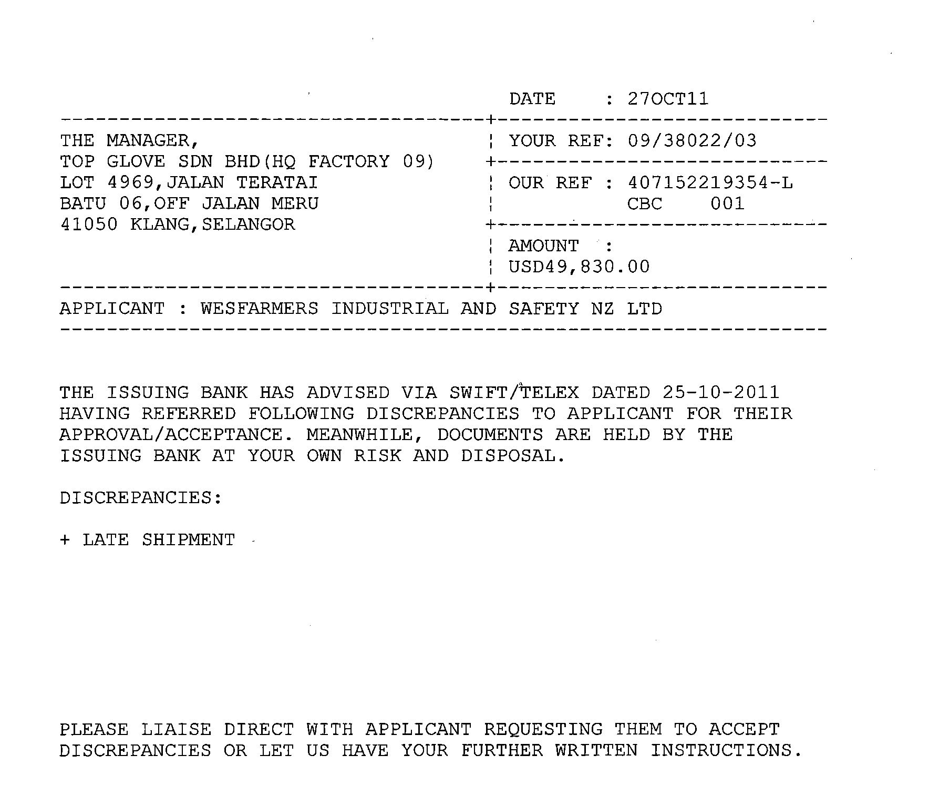
TOP GLOVE, TOP QUALITY, TOP EFFICIENCY
GOOD HEALTH, SAFETY FIRST & BE HONEST

Slide 34
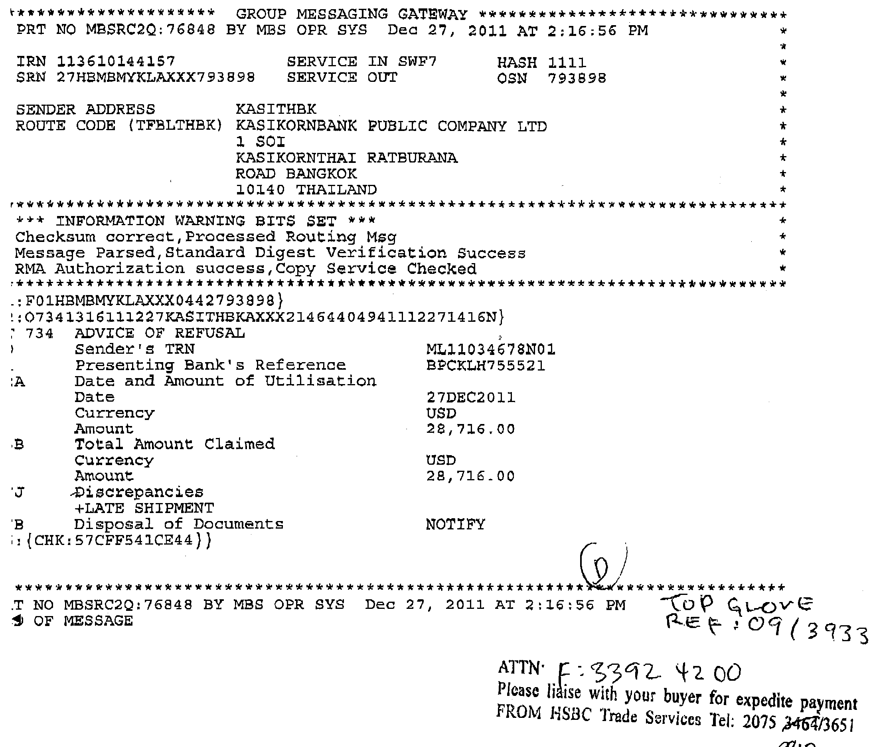

Slide 35
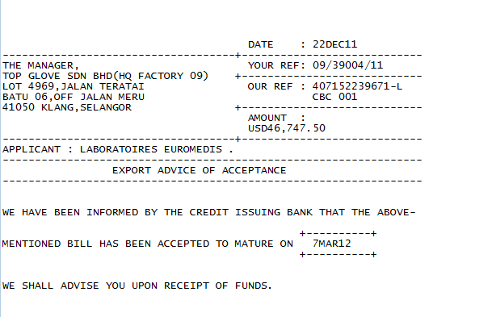
TOP GLOVE, TOP QUALITY, TOP EFFICIENCY
GOOD HEALTH, SAFETY FIRST & BE HONEST

Slide 36
Examination of Documents
TOP GLOVE, TOP QUALITY, TOP EFFICIENCY
GOOD HEALTH, SAFETY FIRST & BE HONEST
A nominated bank acting on its nomination, a confirming bank, if any, and
the issuing bank are required to examine the documents within a maximum
of 5 banking days following the day of presentation. In the event of
discrepancies being observed, the applicable bank is required to provide a
notice of refusal (according to UCP 600 article 16) to the presenter, no later
than the close of that 5th banking day.
The examination of the documents takes three steps:
1. examination of the documents against the terms of the LC;
2. examination of the documents against the applicable provisions of UCP;
examination of the data in the documents with similar data in other
stipulated documents.

Slide 37
What is LC Discrepancies ?
TOP GLOVE, TOP QUALITY, TOP EFFICIENCY
GOOD HEALTH, SAFETY FIRST & BE HONEST
Any inconsistence or difference from the terms and conditions stipulated in the letter of credit in minute details.

Slide 38
Handling of Discrepant Documents
TOP GLOVE, TOP QUALITY, TOP EFFICIENCY
GOOD HEALTH, SAFETY FIRST & BE HONEST
UCP 600 article 14 - Standard for Examination of Documents
Sub-article 14 (b):
A nominated bank acting on its nomination, a confirming bank, if any,
and the issuing bank shall each have a maximum of five banking days
following the day of presentation to determine if a presentation is complying.
This period is not curtailed or otherwise affected by the occurrence on or after
the date of presentation of any expiry date or last day for presentation.

Slide 39
Discrepancies
TOP GLOVE, TOP QUALITY, TOP EFFICIENCY
GOOD HEALTH, SAFETY FIRST & BE HONEST
Two types of discrepancies
  ones that can be remedied by the beneficiary prior to presentation at issuing bank
    buyer probably won’t know they existed
  ones that can’t
    these require approval by the buyer and the issuing bank
      missed critical dates (latest shipment, expiry, presentation)
      problems with the B/L
      third party documents

Slide 40
Discrepancies
TOP GLOVE, TOP QUALITY, TOP EFFICIENCY
GOOD HEALTH, SAFETY FIRST & BE HONEST
Discrepancies can:
  Cause payment delays
  Cause payment rejections
  Eliminate your risk protection
  Add extra time and cost to the transaction
Discrepancies CAN be avoided!

Slide 41

To Pay or Not to Pay?
Documents Comply
Documents are Discrepant
GO!
Bank Must Pay!
Bank Must Refuse!

Slide 42
Common Discrepancies
TOP GLOVE, TOP QUALITY, TOP EFFICIENCY
GOOD HEALTH, SAFETY FIRST & BE HONEST
(1) Drafts
Draft amount is different from invoice
Draft tenor is different from the L/C
Wrong drawee

Slide 43
Common Discrepancies
TOP GLOVE, TOP QUALITY, TOP EFFICIENCY
GOOD HEALTH, SAFETY FIRST & BE HONEST
(2) Commercial invoices
Different merchandise description from the L/C
Invoices is not issued by the beneficiary
Incorrect accountee's name and address are stated
Different prices from the L/C
Terms of trade such as FOB, CFR or CIF different from the L/C
Different currency from the L/C

Slide 44
Common Discrepancies
TOP GLOVE, TOP QUALITY, TOP EFFICIENCY
GOOD HEALTH, SAFETY FIRST & BE HONEST
(3) Packing list
Different description of merchandise from the L/C
Different net weight and gross weight from the B/L

Slide 45
Common Discrepancies
(4) Ocean Bill of Lading
Less than a full set of original B/L is presented
The B/L not properly endorsed
The B/L not marked with "On Board“ notation, if B/L contains the indication “intended vessel” or "Received for shipment"
The B/L not properly consigned.
In the case of CFR or CIF, the term "Freight Prepaid" is not marked, that is, no indication of freight prepaid by the exporter
Merchandise description is different from the L/C

Slide 46
Common Discrepancies
TOP GLOVE, TOP QUALITY, TOP EFFICIENCY
GOOD HEALTH, SAFETY FIRST & BE HONEST
(4) Ocean Bill of Lading (continued)
Different ports of loading and/or unloading from the L/C
Late shipment: The bill of lading date marked later than the shipment date specified in the L/C

Slide 47
Common Discrepancies
TOP GLOVE, TOP QUALITY, TOP EFFICIENCY
GOOD HEALTH, SAFETY FIRST & BE HONEST
(5) Marine Insurance Certificate or Policy
Different coverage from the L/C
Insufficient coverage
Not the same currency as the L/C
Different merchandise description
The effective date later than the shipment date

Slide 48
Common Discrepancies
TOP GLOVE, TOP QUALITY, TOP EFFICIENCY
GOOD HEALTH, SAFETY FIRST & BE HONEST
(6) Other discrepancies
Not all documents required in L/C are presented
Documents are presented after the expiry date of the L/C

Slide 49
Negotiation with Discrepancies
TOP GLOVE, TOP QUALITY, TOP EFFICIENCY
GOOD HEALTH, SAFETY FIRST & BE HONEST
In case discrepancies are found by negotiating bank, exporter must correct the discrepancies.
If exporter cannot correct them such as the shipping date, then exporter should
request the issuing bank to amend the letter of credit to cover discrepancies or authorize to pay in lieu of discrepancies
At the same time, inform the buyer of the discrepancies and request his acceptance and amendment to the Letter of Credit.
Release shipping documents to issuing bank after the L/C is amended. Buyer’s acceptance of discrepancies are not enough. The Letter of Credit must be amended.
Do not send the shipping documents to the issuing bank on a collection basis.

Slide 50
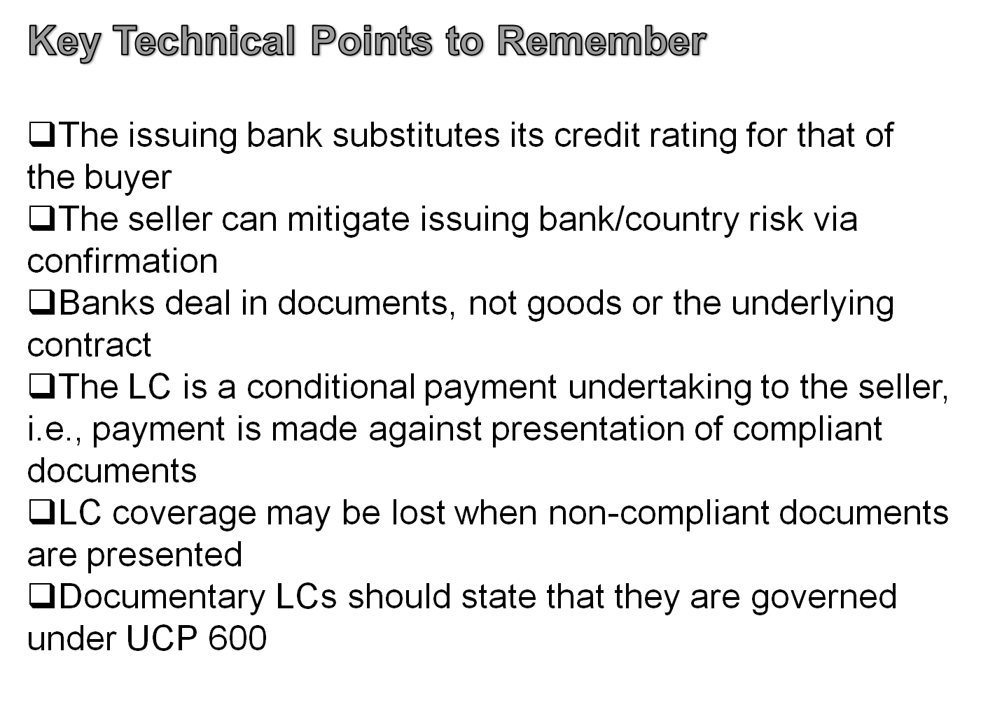
TOP GLOVE, TOP QUALITY, TOP EFFICIENCY
GOOD HEALTH, SAFETY FIRST & BE HONEST

Slide 51
LC Confirmation
TOP GLOVE, TOP QUALITY, TOP EFFICIENCY
GOOD HEALTH, SAFETY FIRST & BE HONEST
What is confirmation?
  A second bank, usually the advising bank, undertakes the credit risk of the bank which issued the LC
    The confirming bank is now obligated to pay against documents in order
    A confirmation is an extension of credit, so the issuing bank must be creditworthy
    LC terms must contain request for confirmation

Slide 52
TOP GLOVE, TOP QUALITY, TOP EFFICIENCY
GOOD HEALTH, SAFETY FIRST & BE HONEST
Confirmation
By confirming a letter of credit, the advising or another bank
assumes the same responsibilities as the issuing bank, including the obligation to pay against presented documents if they are in order and all of the letter of credit terms are met. In effect, the beneficiary has the individual promise of two banks to pay against conforming documents; the issuing bank and the confirming bank.

Slide 53
TOP GLOVE, TOP QUALITY, TOP EFFICIENCY
GOOD HEALTH, SAFETY FIRST & BE HONEST
Why Request Confirmation?
The beneficiary may have concerns about the political or economic stability of the buyer's country, or the strength and reputation of the issuing bank. Confirmation by a bank known and convenient to the seller promotes the commercial utility of letters of credit. Also in the event of a dispute, jurisdiction will be determined by the confirming bank's location.

Slide 54
LC Confirmation
TOP GLOVE, TOP QUALITY, TOP EFFICIENCY
GOOD HEALTH, SAFETY FIRST & BE HONEST
Reasons a Bank May Not Confirm an LC
Weak country credit risk
Issuing bank credit line constraints
Reimbursement instructions
Legal issues

Slide 55
TOP GLOVE, TOP QUALITY, TOP EFFICIENCY
GOOD HEALTH, SAFETY FIRST & BE HONEST
Manage LC Terms & Conditions
 Design a Letter of Credit Instruction Form for buyers
– Provides buyers with your company’s required LC terms/conditions
– Can be customized for different countries, products and regions
– May be detailed or contain only key data elements
 Provide the LC Instruction Form to your sales representatives to present to buyers in advance or to attach to sales contracts
 Post your LC Instructions on your company’s Web site

Slide 56
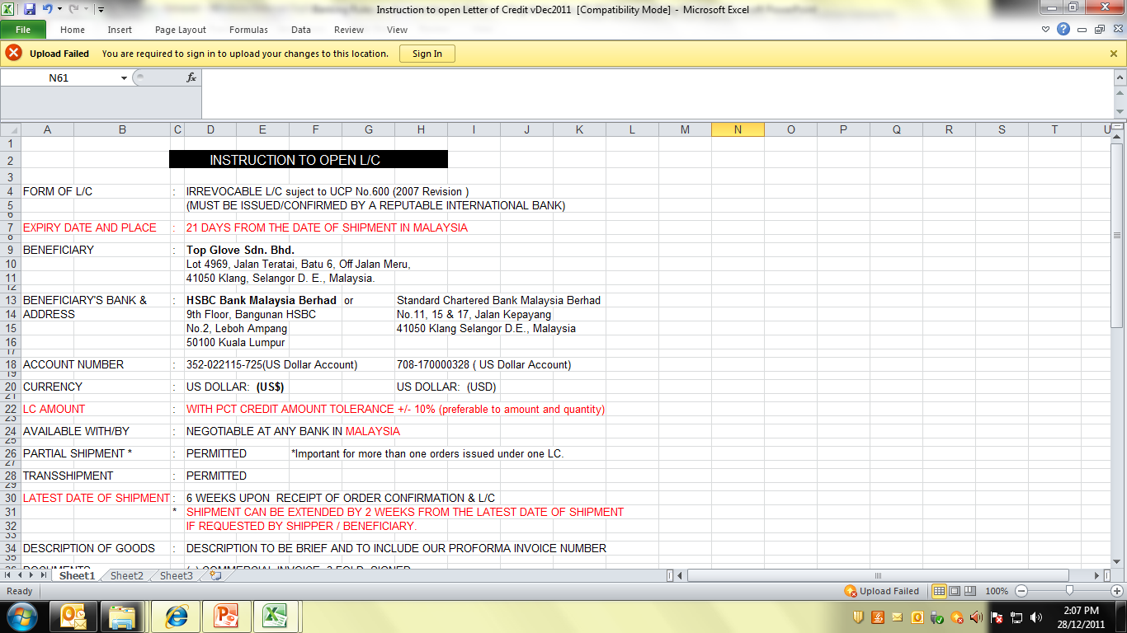

Slide 57
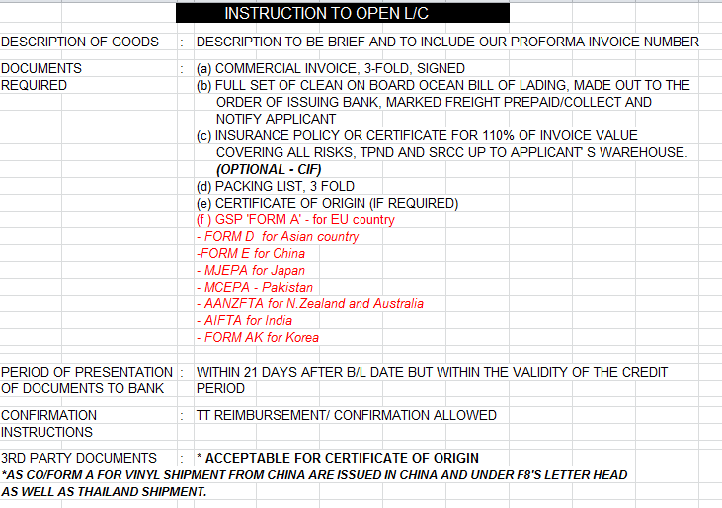

Slide 58
Examination of a Letter of Credit
TOP GLOVE, TOP QUALITY, TOP EFFICIENCY
GOOD HEALTH, SAFETY FIRST & BE HONEST
When a letter of credit is received, exporter must:
(1)Examine the conditions and documents specified in the L/C and determine whether he can meet them or not.
(2) If there are any conditions we cannot meet, request his buyer to amend the L/C before we starts manufacturing export goods.
(3)Hold off shipping the order until we receives an amendments to the L/C as requested.

Slide 59
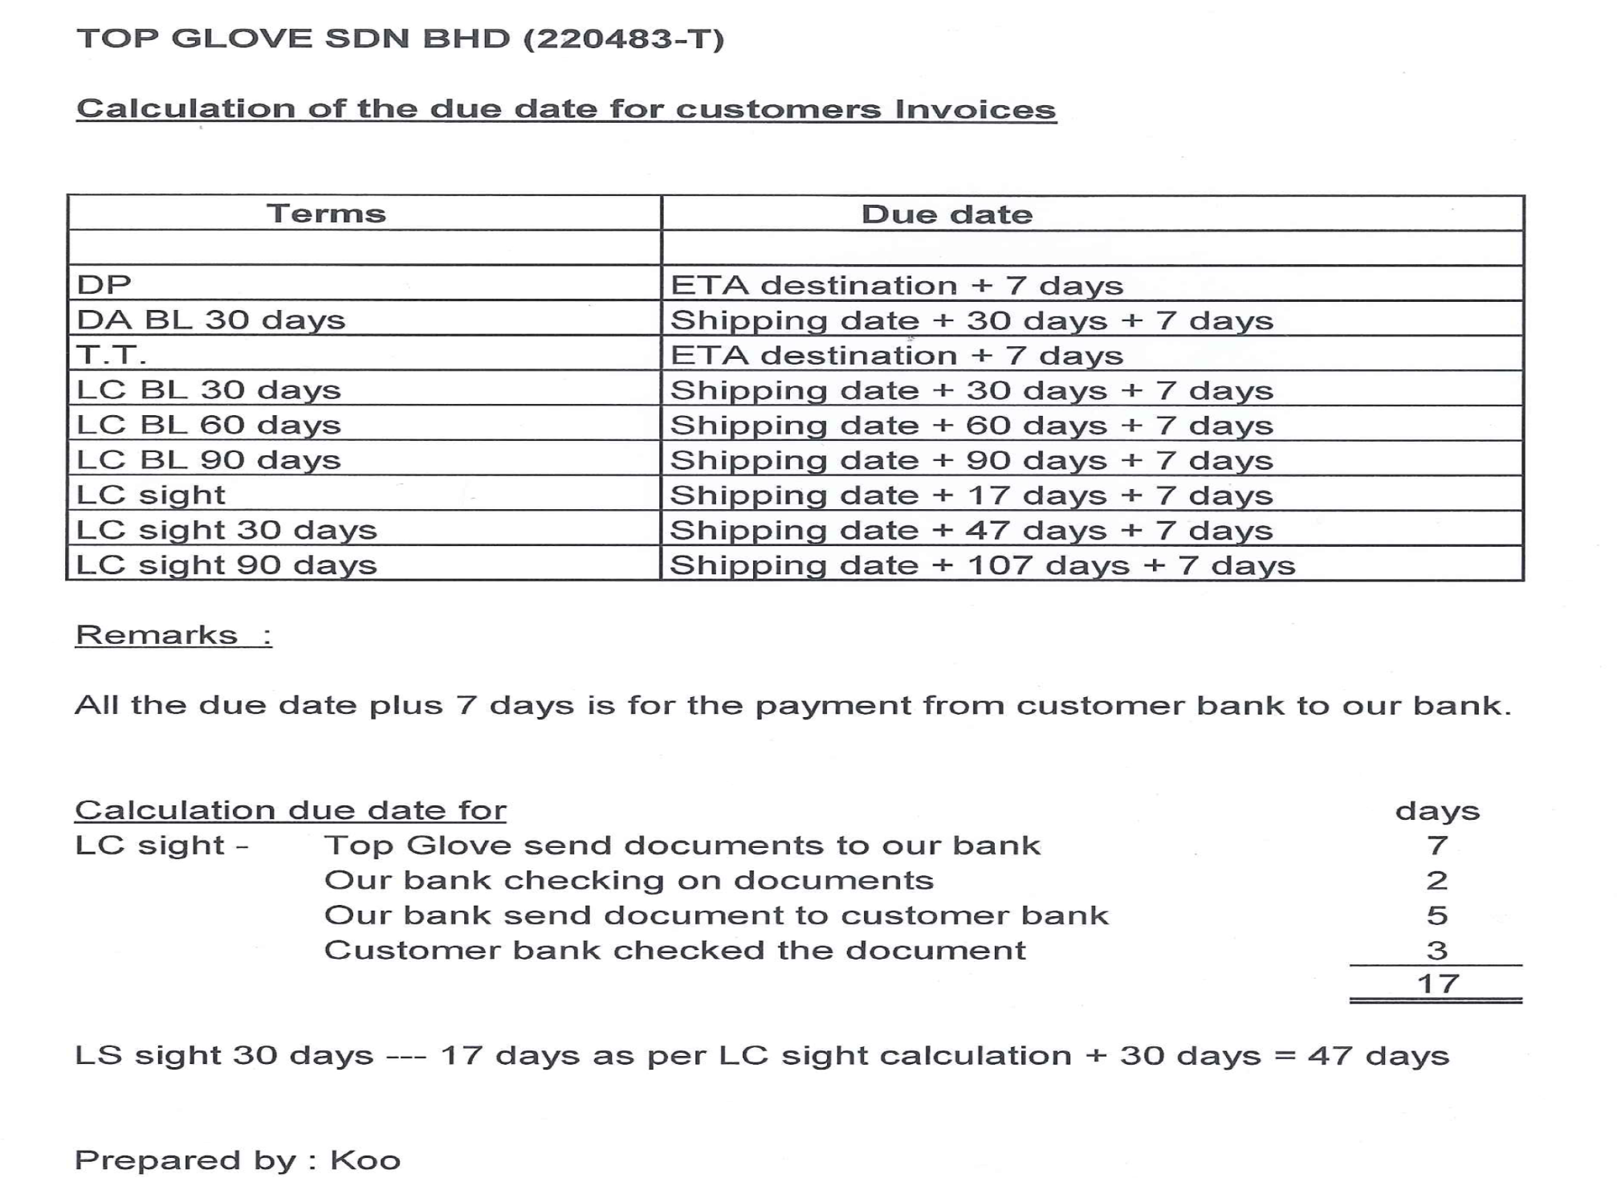

Slide 60
Banking Rules on Documentary Collections/Negotiation/Compliance/
Negotiation/Discrepancy/Settlement
TOP GLOVE, TOP QUALITY, TOP EFFICIENCY
GOOD HEALTH, SAFETY FIRST & BE HONEST
Thank You
Contact : Woon Sook Chuen – F20 – Ext 212
Email : scwoon@topglove.com.my

